Slide 1
HELLO!
We are Group-18
With Our project YoutubeSubtitle Downloader

Slide 2
YoutubeSubtitle Downloader

Slide 3





OUR TEAM (Group – 18)
SOUMESH SANTRA (Research)
12019004009107
Department of Computer Applications
UEM, Kolkata
ARINDIP DUTTA (Documentation)
12019004009098
Department of Computer Applications
UEM, Kolkata
RAJA SAHA (Code)
12019004009099
Department of Computer Applications
UEM, Kolkata
TANAY MONDAL (Documentation)
12019004009043
Department of Computer Applications
UEM, Kolkata
RISHAV KHAMRUI (Research)
12019004009057
Department of Computer Applications
UEM, Kolkata

Slide 4
TABLE OF CONTENTS
INTRODUCTION OF OUR PROJECT
HOW TO USE
CODE
CONCLUSION
2
4
6
8
1
3
5
7
ACKNOWLEDGEMENT
OTHER SIMILAR TOOLS
USE CASE DIAGRAM
FUTURE WORKS

Slide 5

ACKNOWLEDGEMENT
KOUSTUV BHATTACHARYA Our HOD
UEM, Kolkata
ANKUR BISWAS Our Supervisor
UEM, Kolkata
SOMNATH BANERJEE Our Class Teacher
UEM, Kolkata
I would like to express our special thanks of gratitude to our supervisor Ankur Biswas, as well as our HOD Kousuv Bhattacharya and our class teacher Somnath Banerjee, who gave us the golden opportunity to do this wonderful project on the topic Youtube-subtitle-Downloader, which also helped us in doing a lot of research and we came to know about so many new things we are thankful to them.

Slide 6



INTRODUCTION OF OUR PROJECT
YouTube implemented Video Captions or Subtitles which show a written transcript over the video as an overlay. But sometimes we need those captions for our work, education, and research purposes. So, we made a simple tool using Python to extract and download the subtitle in a text file from the particular Youtube Video Link.

Slide 7
OTHER SIMILAR TOOLS
OTHER TOOLS
There is a vast number of websites and software available to download subtitles. But whenever we use this third-party tool, we are being used for ad targeting or it may be collecting our valuable data and selling it to the companies which later used it for ad targeting.
OUR PYTHON TOOL
But our python tool which we have created is completely ad-free, easy to use, and open source for anyone to use or modify for their preferences.

Slide 8
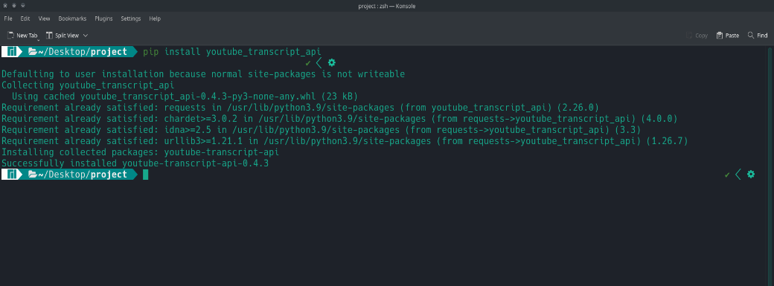
HOW TO USE
Requirement
For this script [youtube_transcript_api] python library is required, to install it type- [pip install youtube_transcript_api] or [pip install –r requirement.txt]

Slide 9
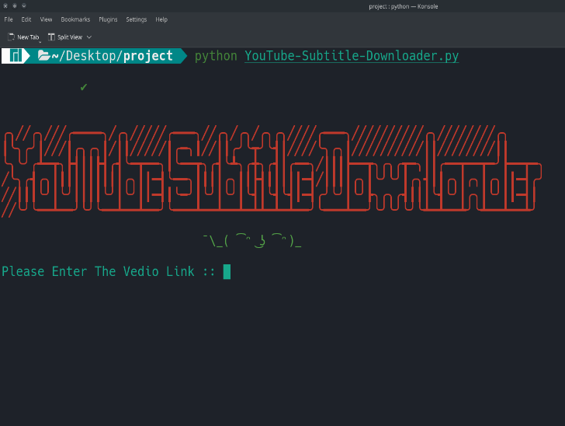
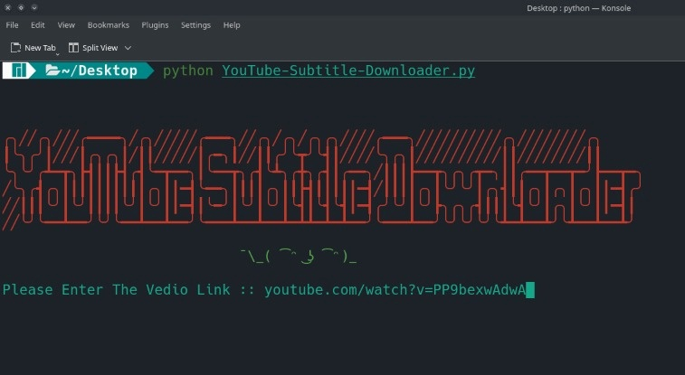
Step 1
Open the terminal and start the tool by typing [python YouTube-Subtitle-Downloader.py] there you can find a prompt where you have to enter the Video URL.
Step 2
Now, we need a YouTube video that at least has one subtitle file attached to it, we need to copy the URL of that particular video.
For example, use this Youtube link – “youtube.com/watch?v=PP9bexwAdwA”

Slide 10
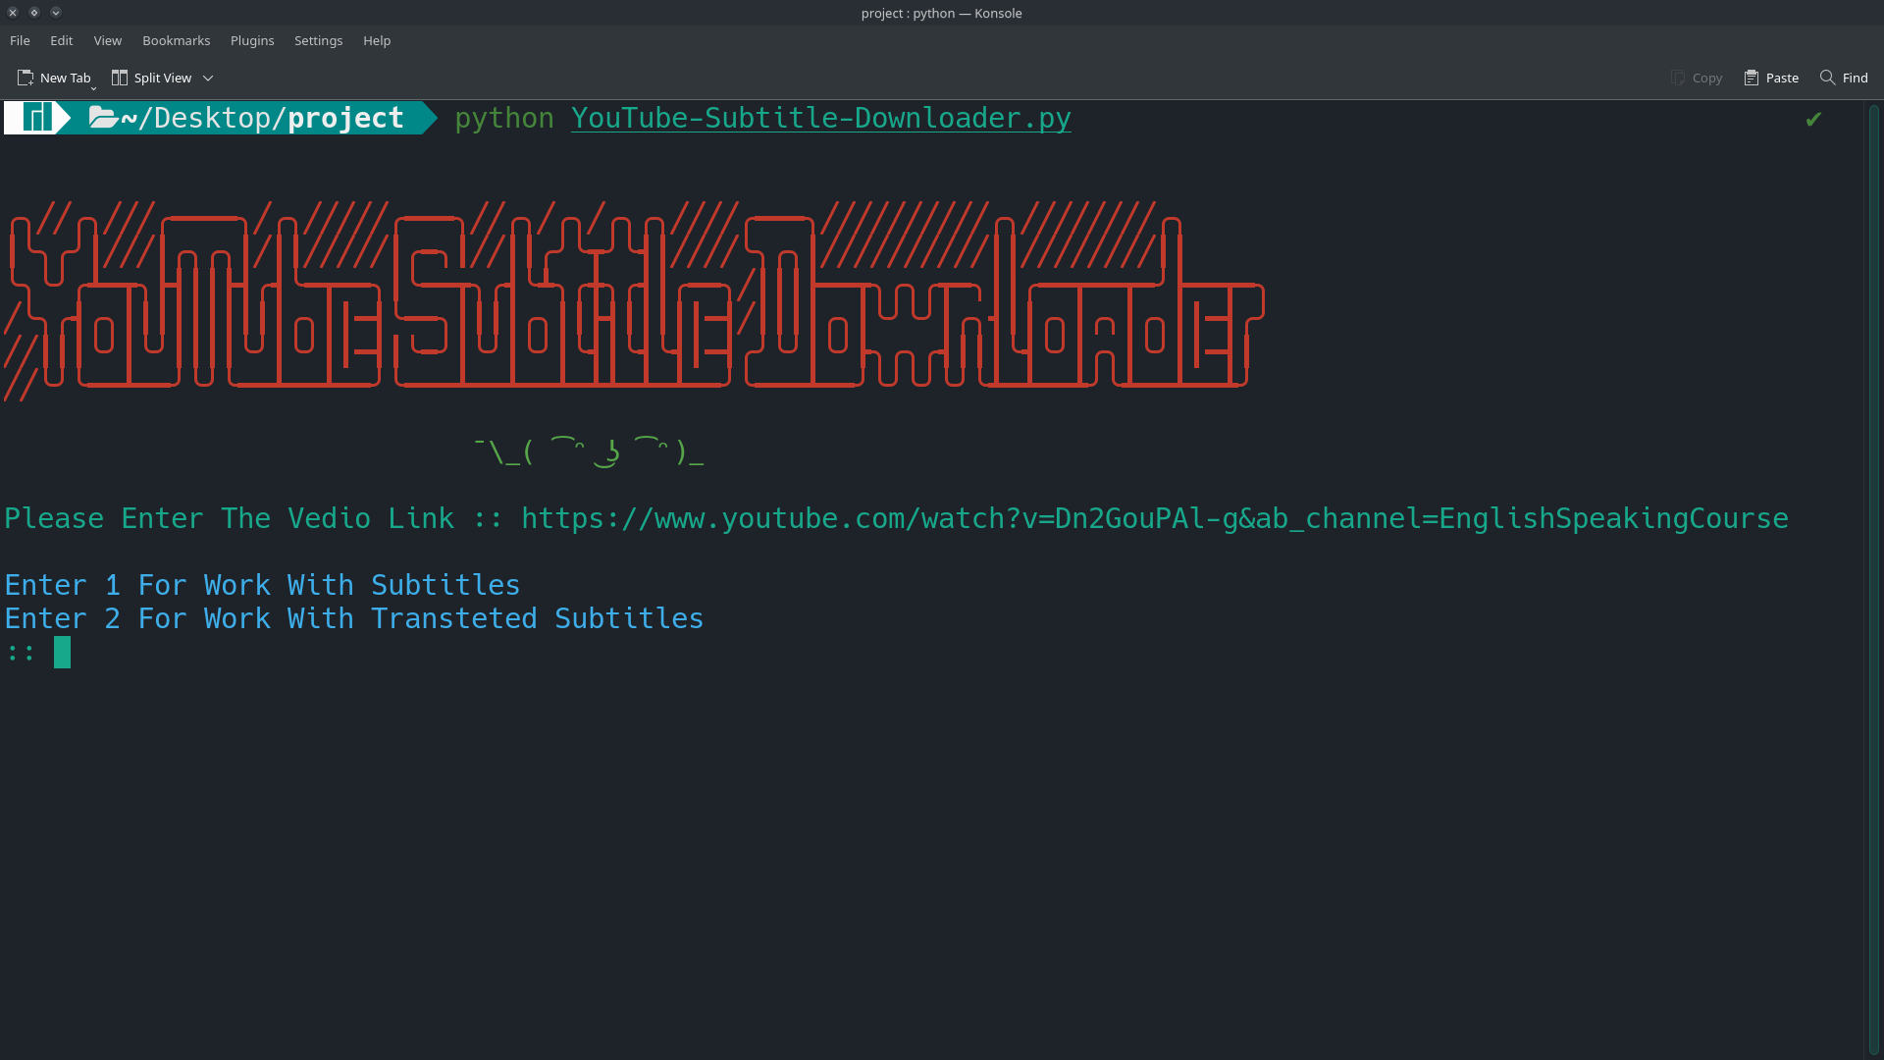
Step 3
When you enter the video URL, there you can find two options, select 1 for the original English subtitle and select 2 for translated subtitles..

Slide 11
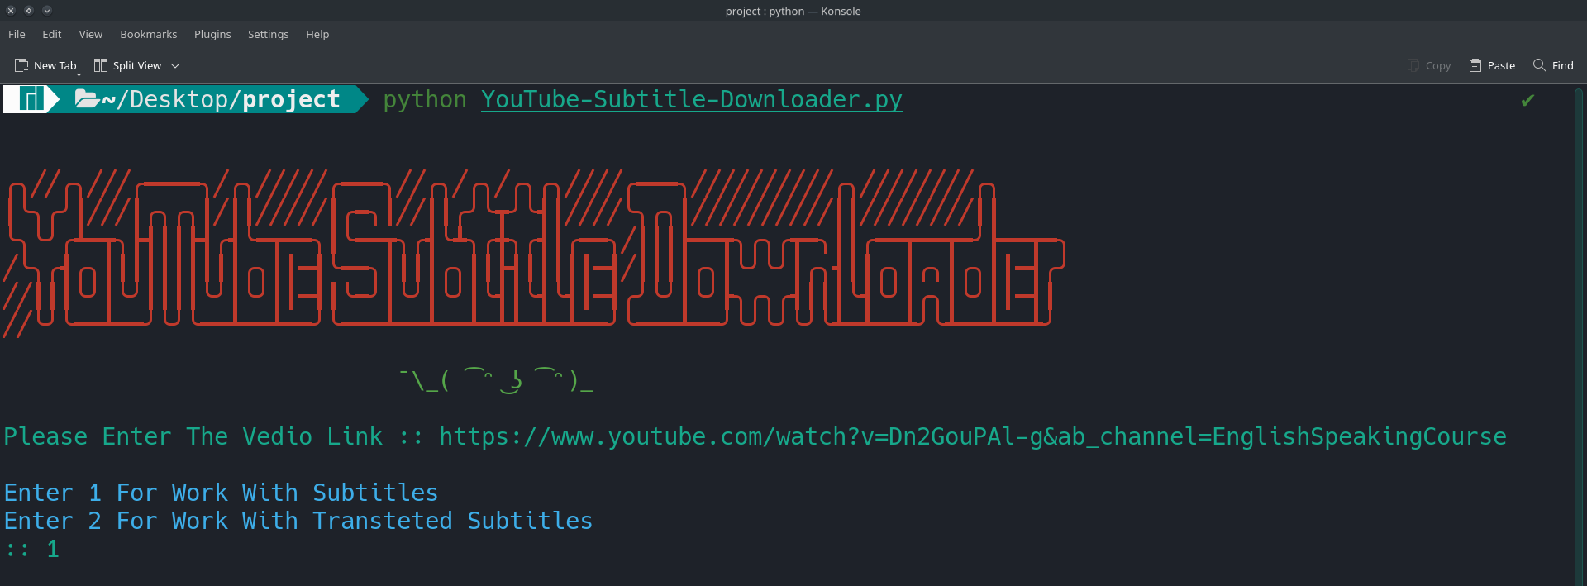
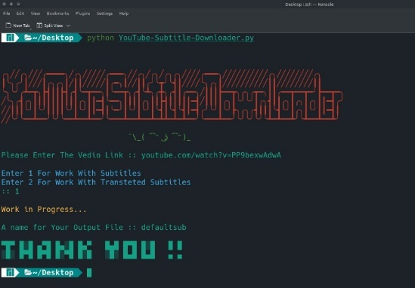
If Select 1 in Step 3
If you choose option 1 for the original English subtitle then you are directly redirected to choose the preferred file name for the subtitle file.

Slide 12
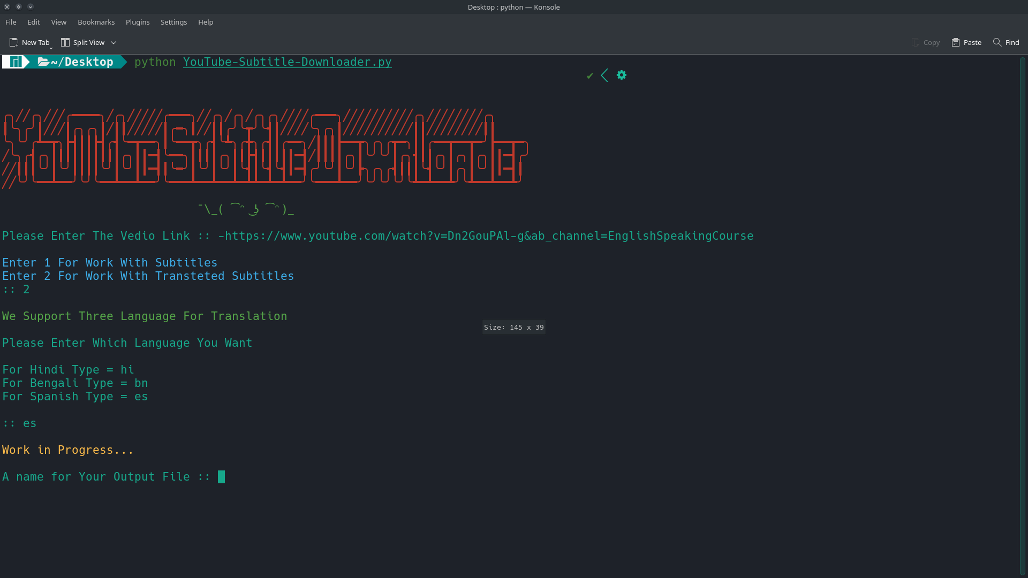
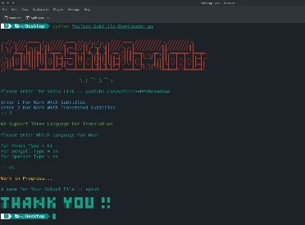
If Select 2 in Step 3
If you selected option 2 for the translated subtitles, there you can find 3 languages Hindi, Bengali, and Spanish. The next step is to select the language using code like ‘hi’ for HINDI, ‘bn’ for BENGALI, and ‘es’ for SPANISH. Then you select your language, you are redirected to choose the preferred file name for the subtitle file.

Slide 13
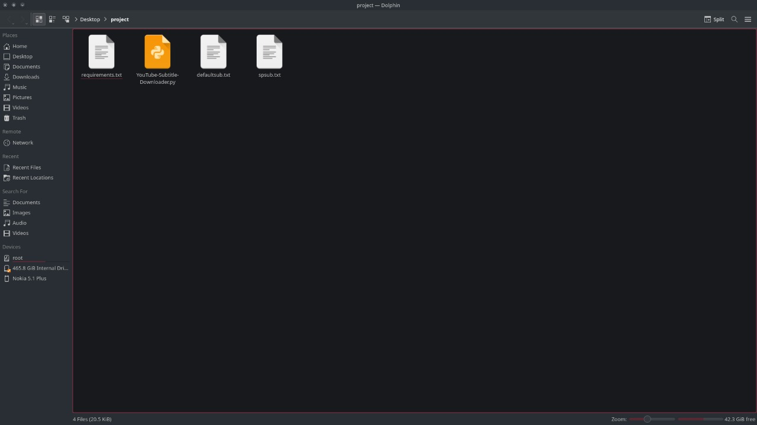
Step 4
In the end, you can find your subtitle file on the same folder which you used to operate the tool.

Slide 14
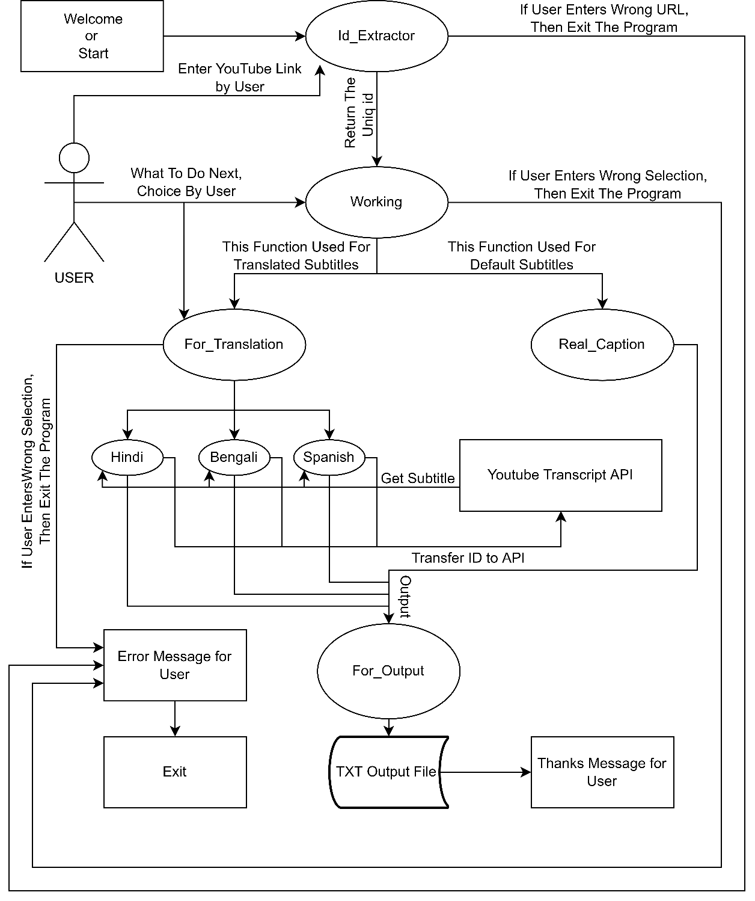
USE CASE DIAGRAM

Slide 15
CODE
Check the program code through this link
https://bit.ly/3qLmmrC

Slide 16

FUTURE WORKS
Our tool currently supports only 4 languages, in the end, our goal is to make the tool prepared for more languages.
With Chrome, extension users can interact with our tool more conveniently.
Currently, we are preparing to make a Chrome Extension so that users can download subtitles in a one-click solution.
If a user watches a video and tries to download the subtitle of that video then the user can click on the extension to directly download the particular subtitle.

Slide 17
CONCLUSION
Here, we have come to the end of our Presentation. We tried our best to include all the necessary points that are required related to our Minor Project. Some of the information we wrote in the presentation were taken from the internet and we have also referred to some books. This presentation contains information about our Minor Project which is related to the YouTube Subtitles Downloader. We do hope that our project will be interesting and maybe even useful to the users.

Slide 18

THANKS!
- Presented By Group-18

